Slide 1

RUNGTA COLLEGE OF DENTAL SCIENCES & RESEARCH
TITLE OF THE TOPIC: GINGIVAL TISSUE
MANAGEMENT
DEPARTMENT OF CONSERVATIVE DENTISTRY AND ENDODONTICS

Slide 2
Specific learning Objectives
At the end of this presentation the learner is expected to know
Core areas* H | Domain ** | Category #
Definition, classification, indication, contraindication | Cognitive | Must know
Techniques of retraction | Psychomotor | Nice to know
Recent advances, History | Affective | Desire to know
*Subtopic of importance
** Cognitive, Psychomotor or Affective
# Must know , Nice to know & Desire to know

Slide 3
Table of Content
Introduction
Definition
Biological width
Indication
Classification
Techniques of retraction

Slide 4


Slide 5
CHEMICAL METHODS

Slide 6
Vasoconstrictors:
epinephrine, non- epinephrine
Hemostasis , vasoconstriction
Biologic fluid coagulants
Coagulate blood ,tissue fluids
Creates surface layer –sealant against blood and fluid
Alum, Aluminium chloride .
Surface layer tissue coagulant
Coagulates sulcular and free gingival epithelium fluids , blood ,
tissue fluids
Zinc chloride ,silver nitrate
Notes:
EPINEPHRINE drug examples SIDE EFFECTS AND CONTRAINDICATIONS safe dose 4 healthy: 0.2mg /200ug 4 cardiac at. – 0.04mg/40ug

Slide 7
CHEMICALS USED
  0.1% and 8% Epinephrine
  100% Alum solution (Potassium Aluminium Sulfate)
  15% and 25% Aluminium Chloride solution
  13.3% Ferric Sulfate solution
  8% and40% Zinc Chloride solution
  15% and 25% Tannic acid solution
Notes:
Epinephrine side effects .. Increased dose cooz of more conc or multiple cords or epi. In LA.or epi . Secretes in stress.Contra – hypr ten. Hyper thyrd. Tricyclic antderprsnt .diabts b blocker .cocaine .

Slide 8
Chemicals carried to field of operation by-
Cords
Drawn cotton rolls
Cotton pellets

Slide 9
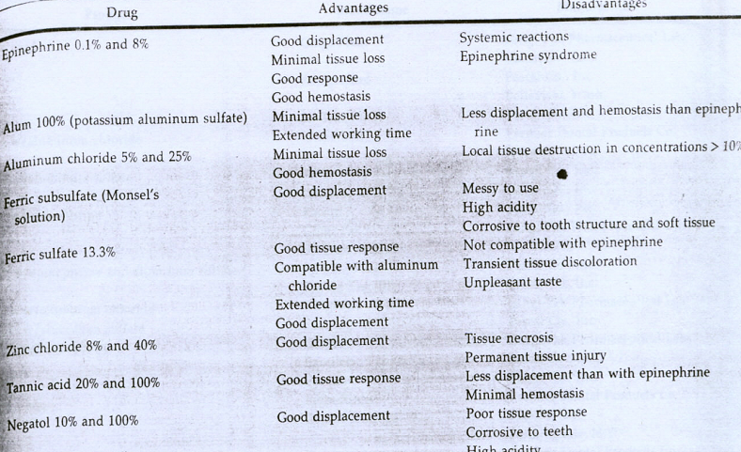
Notes:
Epinephrine conc. 0.1,0.2 ,2,4,8,26,32 8 % is most commonly used Many author: not beyond 4 %

Slide 10
ELECTROSURGERY
  History
  Experiments of d’Arsonvol (1891) demonstrated that electricity at high frequency will pass through a body without producing a shock (pain or muscle spasm), producing instead an increase in the internal temperature of the tissue.
  This discovery was used as the basis for eventual development of electrosurgery.

Slide 11
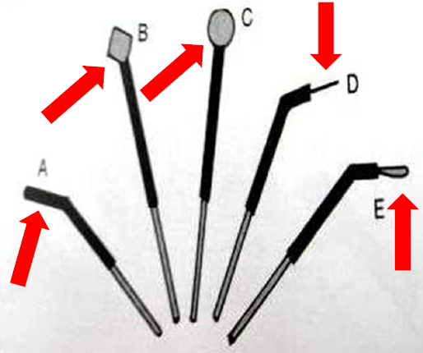
Mechanism of action
Alternating electric current is passed through a certain apparatus with gradually increasing the frequency ( from 60 to 120 to a million or more per second ).
This high velocity current can pass through human body without inducing shock .
The whole electric energy is concentrated at tiny electrodes , producing localized tissue changes , confined to 2-3 cell layers.

Slide 12
Rules for Electrosurgery
Proper isolation of the tooth and the adjacent area .
Tissue should be sufficiently moist .
The patient should be well conducted and grounded .
Only fully rectified , undampened ,filtered current should be used .
Shallow involvement of the sulcular epithelium should be done.
Electrodes should be used with light touches and rapid intermittent strokes to create a sulcular trough.
Crest of the free gingiva should never be involved in the line of cutting .
Notes:
Current on dry tissue is very detrimental… read about all the currents used . Crest involvement leads to loss of gingival height recession …speed 7 mm /sec …………….. Strokes should not be repeated with in 5 sec ..

Slide 13
Cutting should be kept in the internal walls of the sulcus .
Metallic restorations should not be touched ,can create a short circuit through the structure .
Electrode should never be approached to the attaching epithelium or periodontal ligament .
Electrodes should be kept cleaned of debris .
If spark appears , lower the electricity output .
After the procedure has been done , create as favourable an environment for healing of the periodontium as possible .
Notes:
Curettage , fresh clot ,,bone exposed than perio pack.

Slide 14
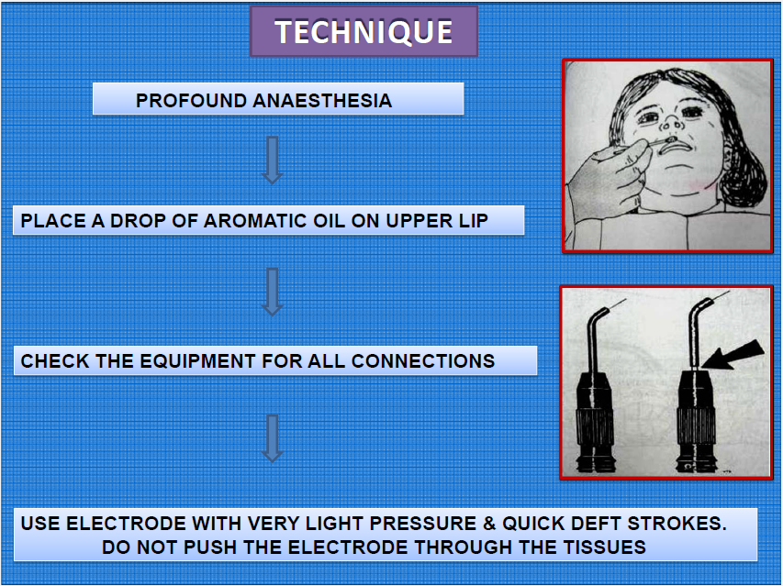

Slide 15
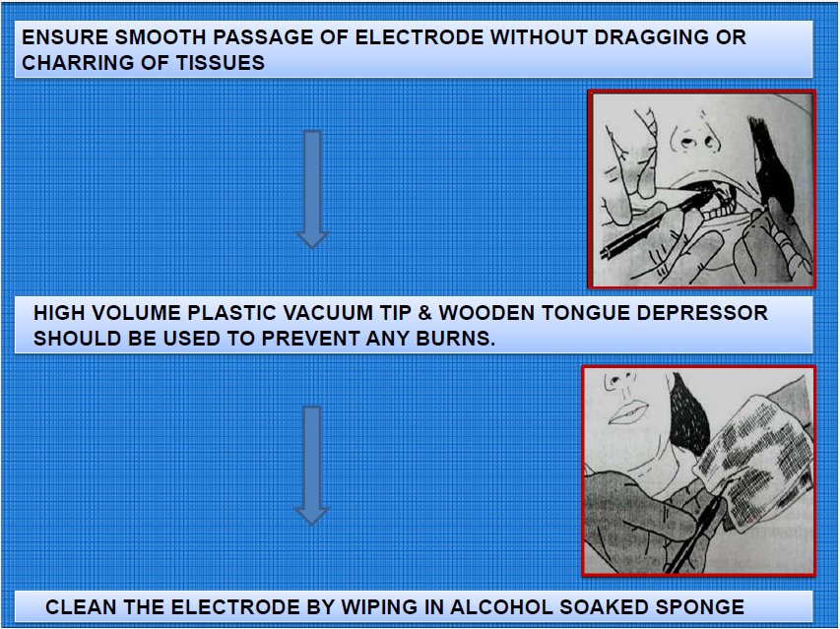

Slide 16
Advantages | Disadvantages
Sophisticated Technique | Very Technique Sensitive
Can Be Done In Case With Gingival Inflammation | Application Of Excessive Pressure-Severe Tissue Damage.
Produce Little / No Bleeding | Difficult To Control Lateral Dissipation Of Heat.
Quick Procedure | Operatory Area Must Be Very Moist During Procedure Compromised Access And Visibility.
Less tissue loss | Not suitable for thin gingiva

Slide 17
Contraindications
Patients with cardiac pacemakers.
Should not be used in presence of flammable agents such as ethyl chloride (topical anaesthetic).
Patients with delayed wound healing .

Slide 18
ROTARY CURETTAGE
The concept of using rotary curettage was described by Amsterdam in 1954.
Rotary curettage is a “troughing” technique, the purpose of which is to produce limited removal of epithelial tissue in the sulcus while a chamfer finish line is being created in tooth structure.
The technique, which has also been called as “gingittage”, is used with the subgingival placement of restoration margins.

Slide 19
Criteria for rotary curettage
1.Must be done on healthy and inflammation free tissue to prevent tissue shrinkage that occurs when diseased tissue heals.
2.Absence of bleeding on probing.
3.Sulcus depth less than 3.0 mm.
4.Presence of adequate keratinized gingiva.

Slide 21
Lasers
Lasers helps in exposure of subgingival finish lines, controls the hemorrhage, and removes just enough epithelial attachment and periodontal ligament to facilitate the placement of retraction cord.
Minimum gingival recession.
Laser tips 320-400 micron in diameter.
Notes:
Diode,Co2, argon,,ND-YAG neodynium yettrium aluminium garnet

Slide 22
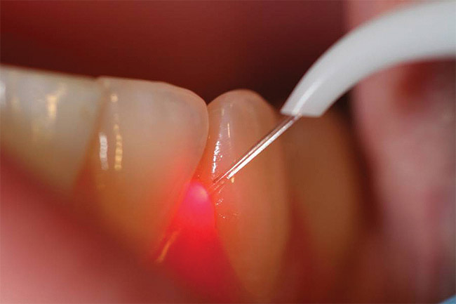
A feather light stroke should be used.
The laser handpiece should be kept moving.
Along with the attached gingiva, approximately 1mm of epithelial attachment should be removed and coagulated to achieve hemostasis and to expose the crown margins.

Slide 23
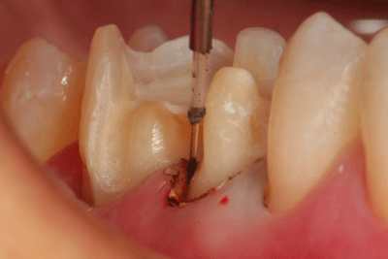
Advantages
Minimum pain ,no discomfort
Less fear, anxiety, stress
Minimum or no anaesthesia
No drill sounds
Less chair time
Reduced post operative complications
Minimum or no bleeding

Slide 24
NEWER METHODS AND MATERIALS

Slide 25
EXPASYL
First expanding PVS material designed for easy and fast retraction of the sulcus and haemostasis without the potentially traumatic and time consuming packing of retraction cords.
Supplied In Syringe As Viscous Paste.
Expasyl Paste Is Injected Into Sulcus, Exerting A Stable, Non-damaging Pressure Of 0.1 N/mm.

Slide 26
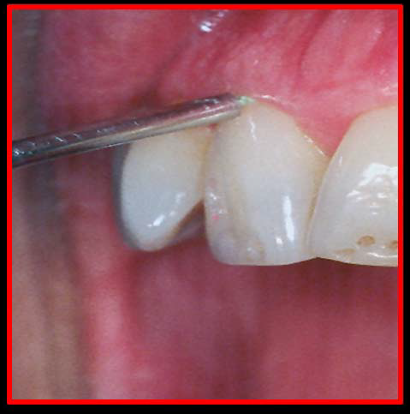
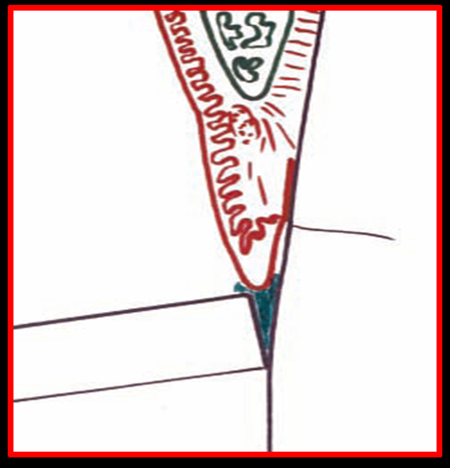
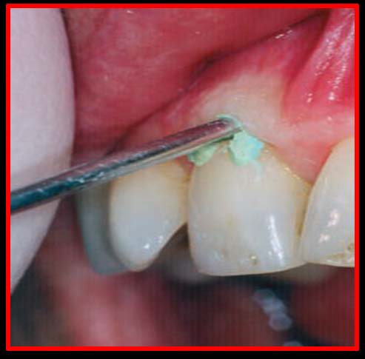
Technique

Slide 27
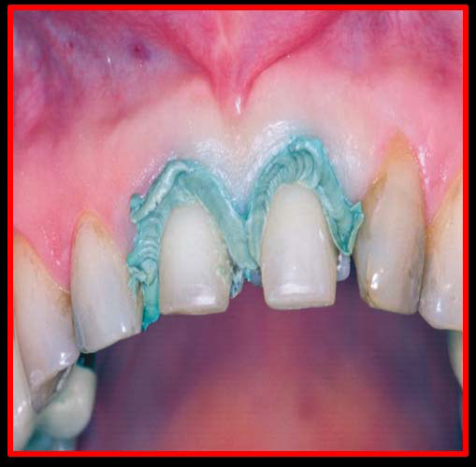
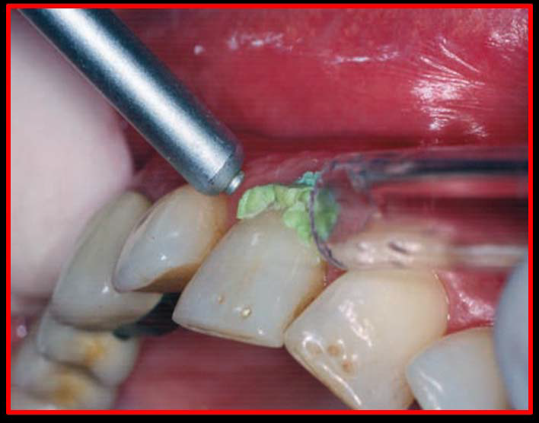
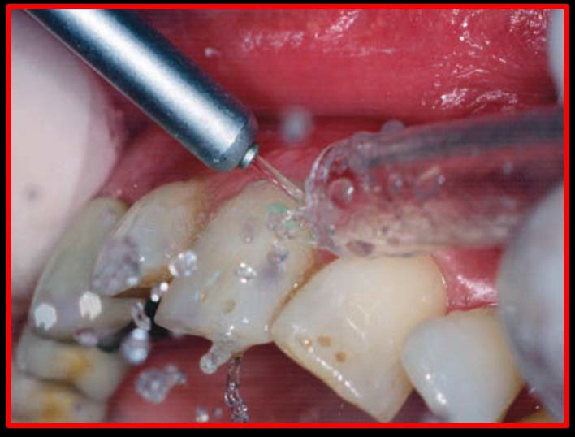

Slide 28
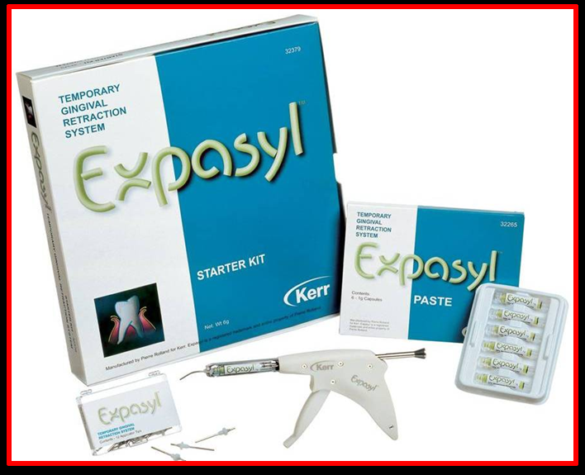
When Left In Place For 1 Min, This Pressure Is Sufficient To Obtain A Sulcus Opening Of 0.5 mm For 2 Minutes.
Equipment Consists Of:
• Capsules
• Injection Canulas
• Applicator
COMPOSITION
1) Kaolin 66.75%
2) Water 23.36%
3) AlCl3 6.54%
4) Colorant 1.02%
5) Essential oil of lemon 0.33%

Slide 29
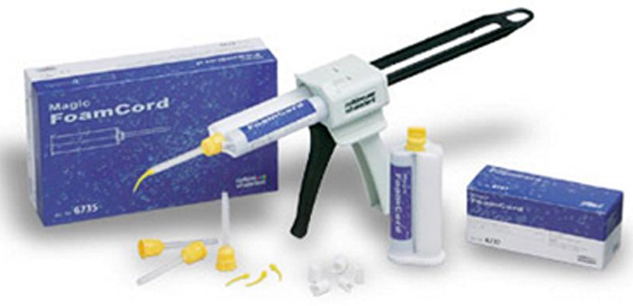
Magic foam
Expanding vinyl polysiloxane material .
Syringed around the crown preparation margins and a cap (Comprecap) is placed to maintain pressure .
less traumatic to the tissues than retraction cord.

Slide 30
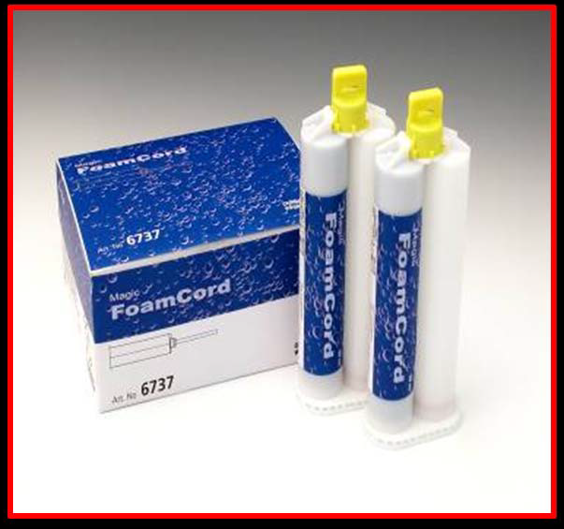
Drawbacks
Tips too large to adequately inject the material into the sulcus .
No haemostatic action .
Hemostasis must be established prior to the use of Magic FoamCord, significantly reducing its clinical efficiency .

Slide 31
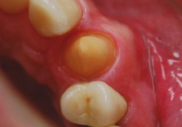
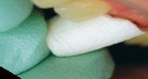
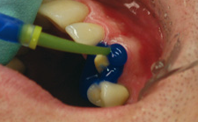
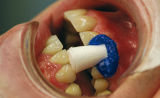
Procedure
Crown preparation prior to retraction
Prefit one comprecap per crown preparation
Apply magic foam around the preparation
Place the comprecap and make patient bite
over it and maintain pressure

Slide 32
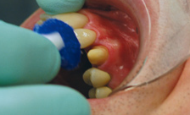
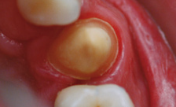
Removal of comprecap with magicfoam
after 5 minutes
Result is wide open sulcus with clear with
clear access to prepared margin

Slide 33
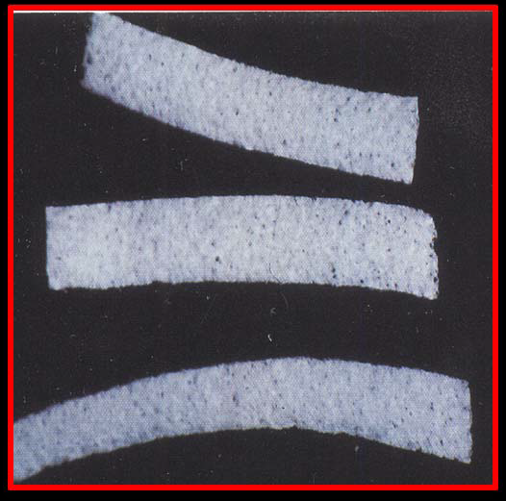
MEROCEL
Synthetic Material, Chemically Extracted From A Bio-compatible Polymer (Hydroxylate Polyvinyl Acetate) That Creates A Net Like Strip -Capable Of Atraumatic Gingival Retraction
Used In Strips Of 2mm Thickness That Expand With absorption Of selected
oral fluids.
Notes:
10-15 minutes

Slide 34
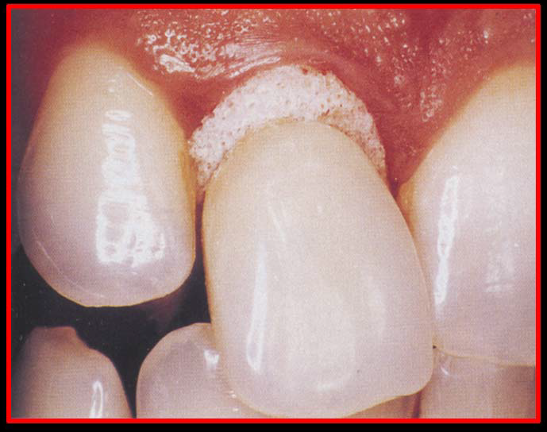
Merocel is:
1)Easily Shaped
2) Effective Absorption Of Intra Oral Fluids
3) Soft & Adaptable To Surrounding Tissues
4) Free Of Fragments
5) Not Abrasive

Slide 35
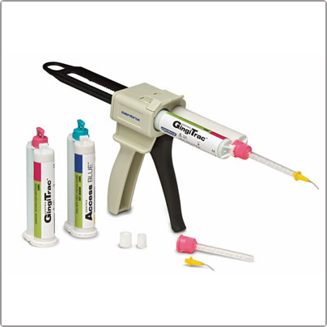
GINGITRAC
A hand-held 2.5 ml syringe with 1:1 astringent and Vinyl Polysiloxane formula .
The two-step procedure -patients bite pressure to push astringent GingiTrac held by a size selected matrix into the sulcus without packing cord.

Slide 36
Whole process takes less than 5 minutes.
More accurate impressions .
No tissue trauma or ligament damage.
Contains a mild, natural astringent to control bleeding and
oozing.
No messy clean up.

Slide 37
Teaching Materials
Operative dentistry: modern theory and practice ;M.A. Marzouk
Shillingburg:Fundamentals of fixed Prosthodontics.
sturdevent’s textbook of operative dentistry
Current concepts in gingival displacement,DCNA 48(2004),433-444.
Current methods of finish-line exposure by practicing prosthodontists. J Prosthodont l999;8:163.

Slide 38
TAKE HOME MESSEGE/ FOR THE TOPIC COVERED (SUMMARY)
There are a variety of techniques and materials that allow the clinician to manage the gingival tissues during restoration and when making an impression.
Gingival displacement is relatively simple and effective when dealing with healthy gingival tissues.
Of the various types of methods available, in most cases, gingival retraction cord along with haemostatic agents is the most effective method for retracting tissue to the depth of the sulcus.

Slide 39
Every method has its advantages and indications. In any case, the control of the soft tissue for exposing the margins of the tooth preparation for restoration and impression making is critical.
It would be worthwhile for the clinician to understand all the choices available.

Slide 40
Question & Answer Session
Describe various chemical methods of gingival tissue management?
Explain electrosurgery in detail?

Slide 41
References
Operative dentistry: modern theory and practice ;M.A. Marzouk
Shillingburg:Fundamentals of fixed Prosthodontics.
Current concepts in gingival displacement,DCNA 48(2004),433-444.
Current methods of finish-line exposure by practicing prosthodontists. J Prosthodont l999;8:163.
Tissue management with a new gingival retraction material: a preliminary clinical report.J Prosthet Dent 1996;75:242.
Clinical trail of gingival retraction cords.J Prosthet Dent 1999:81:258.

Slide 42


